Slide 1
Financial reporting for ASIC
November 2019 | Tips, traps and pitfalls

Slide 2
Disclaimer
This presentation is for your general information only, and should not be taken as specific financial or business advice. You should not act, or refrain from acting, on the basis of this presentation alone, without seeking specific advice from your advisers.
Nevertheless, this presentation has been carefully prepared based on the information available at the time of the presentation.

Slide 3
Alastair Abbott
CA, B.Comm., GradDipCA, M. Forensic Accounting, MAICD, Registered Company Auditor, Registered Self-Managed Super Fund Auditor
Alastair takes a special interest in financial reporting, accounting standards and their application to various entities.
Over the last 11 years at Australian Audit, he has gained vast experience across auditing and financial reporting for many different industries.
In his spare time, he chairs the Perth Audit discussion group, and is honorary treasurer for a local charity.
Alastair@ausaudit.com.au | 08 9218 9922

Slide 4
Session Outline
The easy part first
Definitions
Who has to lodge with ASIC / be audited
What are compliant financials
Common errors
Looking to the future
Notes:
Today will cover for profit entities reporting to ASIC
Outline of session
Start with a bit of theory to clear up some misconceptions, then look at the practical aspect

Slide 5
Definitions
Recognition and Measurement
RG85
Types of reports
Super Special Purpose
SPFR
RDR
GPFR
Notes:
Just want to make sure we are all on the same page – using same language

Slide 6
Who has to lodge with ASIC?
All disclosing entities (generally >100 shareholders)
Public companies
AFSL holders
Companies limited by guarantee (except small Ltd)
Large Pty Ltd (note changing thresholds)
Registered managed investment schemes
Small foreign controlled (and not exempt)
Small with crowd sourced funding
Small Pty Ltd and directed by ASIC or shareholders
Notes:
If you are unsure – read ASIC website – clear guidance of requirements is listed (ASIC INFO 31)
Note changes in ASIC Thresholds – must consider consolidated figures in determining threshold
Assets - $12.5m to $25m
Turnover - $25m to $50m
Staff – 50 to 100

Slide 7
Who has to be audited?
All disclosing entities (generally >100 shareholders)
Public companies
AFSL holders
Companies limited by guarantee (except small Ltd)
Large Pty Ltd (note changing thresholds)
Registered managed investment schemes
Small foreign controlled (and not exempt)
Small with crowd sourced funding
Small Pty Ltd and directed by ASIC or shareholders
Notes:
Company Ltd Guarantee – may have review below $1m
Small Pty Ltd & directed – audit if requested as part of direction

Slide 8
Financials vs Financials?
Not all special purpose financials are equal
Notes:
Who has to lodge is the easy part – now looking at what to lodge is where it becomes more complex
If there is no consistent minimum standard, financial reporting becomes meaningless

Slide 9
Why is there confusion?
AASB Research Report 10 (legislative reporting requirements – Sep 2019)
11 different types of for profit reporting from legislation. E.g.
(1) Preparation of financial statements according to Accounting Standards (as issued by the AASB)
(4) Preparation of financial statements providing a true and fair view of financial operations
(11) Financial records/other
AASB Research Report 12 (for profit lodging SPFR – Aug 2019)
Use of SPFR remains extensive, Quality of SPFR remains poor
Evidence shows there are users
34% of entities extent of R&M compliance was unclear
The reporting entity concept is neither well-understood nor always applied as intended
Notes:
Many and varied reporting requirements from different legislation
Current practice is poor, i.e. 1/3 of reports note 1 wasn’t sufficient to know if R&M applied or not
Regulators have advised reporting entity concept is not enforceable as uses too much judgement
Self assessment of SPFR has resulted in inconsistent application of R&M in RG85 – reports are not consistent, comparable, transparent or enforceable
Diversity in practice regarding consolidation and equity accounting
Changes coming soon – but more on that later

Slide 10
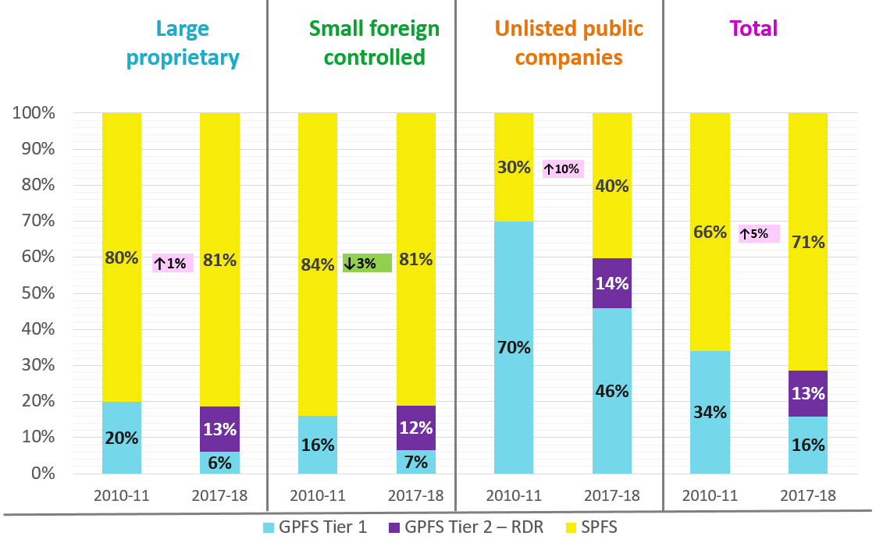
Notes:
Figure 1 Comparison with Research Report No. 1: Summary of Large Proprietary, Small Proprietary controlled by Foreign companies and Unlisted Public Companies Lodging Each Type of Financial Statements in 2010/11 and 2017/18
-Source – AASB Research Report 12
For those reporting to ASIC – what type of reports are being used?

Slide 11
What are compliant financial reports?
Satisfies the legislative or regulatory or constitutional requirements for financial reporting
Identifies the applicable reporting framework
Presents a true and fair view of financial position and performance
Notes:
Regulatory – i.e. AFSL from FS70 is more than act

Slide 12
Where are the relevant requirements?
Corporations Act 2001
The Conceptual framework
APES 315 Compilation Reports
The organisation’s governing document (constitution)

Slide 13
Corporations Act 2001
Financial reporting required under Chapter 2M
S295 – contents of annual financial report
S296 – compliance with accounting standards and regulations
S297 – true and fair view
A distinction between reporting and non reporting entities
RG 85 Reporting requirements for non-reporting entities
Issued July 2005
Notes:
Corps Act requires compliance with accounting standards
Accounting standards allow reporting / non reporting entity separation
So have RG85 for reference

Slide 14
What is a reporting entity?
Reporting entities are described in Statement of Accounting Concepts SAC 1 – Definition of the Reporting Entity
Reporting entities are all entities (including economic entities) in respect of which it is reasonable to expect the existence of users dependent on general purpose financial reports for information which will be useful to them for making and evaluating decisions about the allocation of scarce resources.
A reporting entity must produce a General Purpose Financial Report applying all relevant Accounting Standards either International or Australian
Notes:
In 2005 ASIC RG85 said reporting entity concept wasn’t being well applied
In 2019 AASB research shows it still isn’t being well applied
SAC 1 significantly changed for entities with public accountability

Slide 15
RG 85 Reporting requirements for non-reporting entities
The accounting standards provide a framework for determining a consistent meaning of ‘financial position’ and ‘profit or loss’ in financial reporting across entities.
In the absence of any such framework, the figures disclosed in financial statements would lose their meaning and could be determined completely at the whim of the directors of individual entities
The profit or loss reported by an individual entity would vary greatly depending upon which individuals were responsible for the preparation of its financial statements.
This would not be consistent with the requirements of the Act for financial reports to give a true and fair view (s297)

Slide 16
RG 85 Reporting requirements for non-reporting entities
Directors of non-reporting entities must also consider carefully the need to make disclosures which are not directly prescribed by accounting standards, but which may be necessary in order for the financial statements to give a true and fair view.
Such disclosures could include certain significant related party transactions.

Slide 17
RG85 Reporting requirements for non-reporting entities
A non-reporting entity should as a minimum produce a special purpose financial report satisfying RG85:
Complies with the recognition and measurement requirements of the Accounting standards and the disclosure requirements of
AASB 101 ‘Presentation of Financial Statements’;
AASB 107 ‘Cash Flow Statements’;
AASB 108 ‘Accounting Policies, Changes in Accounting Estimates and Errors’; and
AASB 1048 ‘Interpretation and Application of Standards’.
AASB 1054 ‘Australian Additional Disclosures’
Small Pty Ltd companies do not have to comply with RG85 unless required to do so by shareholders or the governing document
Notes:
1054 – not listed in RG85 due to age of document

Slide 18
APES 315 – Duties as a preparer
Apply expertise in accounting and financial reporting
Assist client to determine appropriate financial reporting framework
Consider acceptance / continuance if appropriate framework not used
Comply with APES 205 (conformity with Accounting Standards)
Issue a compilation report (not required for audited accounts)

Slide 19
APES 205 – comply with accounting standards
Members should take all reasonable steps to apply the principles and guidance provided in the Statements of Accounting Concepts and the Framework for the preparation and presentation of Financial Statements issued by the AASB when assessing whether an entity is a Reporting Entity.
For SPFR, ensure report clearly identifies:
That financials are special purpose
The purpose that accounts were prepared for
The significant accounting policies adopted

Slide 20
Legislative requirements for True & Fair
Corporations Act section 297 (true and fair view);
The financial statements and notes for a financial year must give a true and fair view of the financial position and performance of the company

Slide 21
What is a True & Fair View?
There is much written on the topic
The prevalent view is that at a minimum
The Financial report must comply with the recognition and measurement principles of Australian Accounting Standards
The Conceptual Framework
AASB 101 the Presentation of Financial Statements

Slide 22
Examples of True & Fair Issues
Creating a Reserve for Redundancy
Then posting redundancy expense transactions direct to the reserve instead of to the normal expenses on the Income Statement
The expenses incurred in the Financial Year have been understated because they appear in the reserve and not on the Income Statement
Thus this is NOT a True and Fair View.

Slide 23
Examples of True & Fair Issues
Creating a Provision for Maintenance Liability
And recording Maintenance expenses on the Income Statement
This is represents maintenance that must be completed but has not been.
The PROBLEM is that maintenance cost has not yet been incurred and no obligating event can be demonstrated
There is no liability – no legitimate expense
The surplus is then understated.
This is NOT a True and Fair View

Slide 24
What should be included in a SPFR?
Notes:
AASB Research Report 12 – SPFR quality remains poor

Slide 25
Special Purpose Financial Statements
Mandatory disclosures are limited to those required by the five standards (must be applied in full)
Any other disclosure that is relevant to a True and Fair View
Specific accounting policies must have sufficient detail to explain departures from accounting standards
The auditor or reviewer has to assess whether or not these specific accounting policies give a True and Fair View
The criteria of only being understandable to the members is not sufficient
Notes:
Research Report 12 – SPFR quality remains poor

Slide 26
AASB 101 Presentation of Financial Statements
Financial statements shall present fairly the financial position, financial performance and cash flows of an entity.
Fair presentation requires the faithful representation of the effects of transactions, other events and conditions in accordance with the definitions and recognition criteria for assets, liabilities, income and expenses set out in the Framework.
The application of Australian Accounting Standards, with additional disclosure when necessary, is presumed to result in financial statements that achieve a fair presentation

Slide 27
A complete set of financial statements comprises (AASB101):
a statement of financial position as at the end of the period;
a statement of profit or loss and other comprehensive income for the period;
a statement of changes in equity for the period;
a statement of cash flows for the period;
notes, comprising significant accounting policies and other explanatory information;
comparative information in respect of the preceding period; and
a statement of financial position as at the beginning of the preceding period when an entity applies an accounting policy retrospectively or makes a retrospective restatement of items in its financial statements

Slide 28
Other Titles for the statements (AASB101)
An entity may use titles for the statements other than those used in this Standard.
For example, an entity may use the title ‘statement of comprehensive income’ instead of ‘statement of profit or loss and other comprehensive income’.

Slide 29
Accounting policies (AASB101)
An entity cannot rectify inappropriate accounting policies either by disclosure of the accounting policies used or by notes or explanatory material
Aus19.1 – entities preparing under 2M shall not depart from a requirement in an Australian Accounting Standard

Slide 30
Accrual basis of accounting (AASB101)
An entity shall prepare its financial statements, except for cash flow information, using the accrual basis of accounting.
an entity recognises items as assets, liabilities, equity, income and expenses (the elements of financial statements) when they satisfy the definitions and recognition criteria for those elements in the Framework

Slide 31
Materiality, aggregation & offsetting (AASB101)
An entity shall present separately each material class of similar items.
Materiality applies to disclosures also
An entity shall present separately items of a dissimilar nature or function unless they are immaterial.
An entity shall not offset assets and liabilities or income and expenses, unless required or permitted by an Australian Accounting Standard.
Exceptions
Gains & loss on disposal of assets
expenditure related to a Provision
Notes:
i.e. a P&L that goes on for 3 pages with all line items listed isn’t following this requirement
Materiality is an override, even for requirements of standards that are mandatory, or provide a list to comply with

Slide 32
AASB101 – other requirements
Some lines items are mandatory (s54)
P&L by nature or function is acceptable
Current / non-current distinction is important
The presentation currency
The level of rounding
Number of shares on issue and reconciliation
Description of nature and purpose of each reserve
Notes:
E.g. current / non-current portions of bank debt
Don’t have unconditional right to defer – i.e. LSL past 7 years and Aged care refundable entry payments
Easy to say ‘these financial statements are presented to the nearest Australian dollar, which is the organisations functional and presentation currency’ – however, this is often missing
Notes to account – need to match to face statements, can list accounting policies with the numbers

Slide 33
Statement of cash flows (AASB107)
Operating cash flows
Receipts from operations ( you may split between type of receipt)
Payments to employees
Payments to suppliers
Investing cash flows
Interest received( may be operating)
Dividends & distributions
Payments for investments (including Plant & Equipment)
Proceeds from sale
Financing cash flows
Interest paid
Funds received from loans
Funds paid on loans
Net increase or decrease in cash
Notes:
Not the headings auto generated by Xero

Slide 34
Australian Additional Disclosures (AASB1054)
Audit Fees
Imputation credits
Cash flow reconciliation

Slide 35
Consolidation – measurement or disclosure?
SAC 1 – reference to economic entity
RG85 – consolidation required for reporting entities
ASIC INFO31 – lodgement of financial reports
Consolidate where required by accounting standards
Different interpretations has lead to variance in practice
Notes:
Controversial – consolidation should be applied
Investment in subsidiary at cost vs at fair value will give a very different set of numbers
Parent entity column not required

Slide 36
SPFR – in summary
Management accounts for purpose of tax return only
Prepare accounts that are useful for owners
Super special purpose still allowed
SPFR if lodged with ASIC
Must comply with minimum requirements
Notes:
Potential for business improvement from quality reporting
More than just a compliance exercise
Ensure compliance with ethical requirements

Slide 37
Common Errors in SPFR
Notes:
Politely described by AASB research as ‘diversity in practice’

Slide 38
Common Errors
AASB 101 Presentation of Financial statements
RDR - No requirement to disclose the impact of new Accounting standards
But Full General Purpose and Special Purpose reports require disclosure
AASB 119 Employee Benefits
Calculating the Net present value of Long service leave entitlement
AASB 13 Fair Value Measurement
Assessing the fair value of assets in a changing environment
Notes:
New accounting standards – it is helpful if you have considered them before writing the note listing the effect that they will have
LSL often not included at all, or if included not using NPV

Slide 39
Common Errors
AASB 116 Property Plant & Equipment
The standard allows cost or revaluation
But requires depreciation on revalued assets
And assessment of impairment
AASB 124 Related party disclosures
RDR allows aggregation of Key management personnel.
GPFR and Special Purpose do not
AASB 138 Intangible assets
Recognising Goodwill on merger or acquisition
Excluding internally generated Goodwill
When to capitalise development costs

Slide 40
Common Errors
AASB 1054 Australian Additional Disclosures
Require disclosure of audit fees, franking credits, reconciliation of Net operating cash flow to net profit
Not required for General Purpose RDR
AASB 1053 Application of Tiers of Australian Accounting Standards
Who can use General Purpose Reduced Disclosure Requirements
Cannot be Tier 1 – for profit private sector & Government entities who have Public accountability
AASB 108 Accounting Policies, Changes in Accounting Estimates and Errors
Change to policy may lead to a restatement of the prior two years balance sheets
A note explaining the impact of the policy change

Slide 41
Common Errors
AASB 137 Provisions, Contingent Liabilities and Contingent Assets
When can you take up a provision – must be an obligating event
When do you have to disclose contingent assets & liabilities
Such as possible costs arising from legal actions & how much detail
AASB 102 Inventories
How do you value inventory
AASB 10 Consolidated Financial Statements
Special Purpose do not have to apply?
General Purpose and RDR do have to apply when “control” of other entities is established

Slide 42
More Common Errors
Current portion of long term debt not separated out
Tax effect accounting not calculated
Annual leave not on balance sheet
Cash flow / changes in equity missing
Note 1 isn’t relevant
Inaccurate information in note 1
No prepayments
No depreciation
No recent revaluations

Slide 43
ASIC Inspection Findings
Findings from ASIC inspections – listed items rarely change
Impairment and other asset values
Revenue recognition
Tax effect accounting
Consolidation
Business combinations
Amortisation of intangibles
Disclosure of estimates and judgments

Slide 44
Use of templates (still require thinking)
Templates are great … but … you still have to apply your expertise!
Only include policies and notes that relate to items in the financial statements
For example
There should not be a policy on leases if there no leases in place.
Notes:
APES315 – have to apply expertise

Slide 45
Looking to the future …
Notes:
Tools to help you
Current exposure drafts

Slide 46
Software and templates
IFRSSystem (https://ifrssystem.com/)
Caseware (https://www.caseware.com.au/)
Xero (https://www.xero.com/au/)
Thomson Reuters – XYZ Model accounts (https://tax.thomsonreuters.com.au/checkpoint/xyz)
Big 4 / Mid tier model financial statements
Notes:
You might be thinking that your current templates or processes are not compliant
Disclaimer – no links to any of these products

Slide 47
Changes currently in process
Comparability, transparency, comprehensibility and consistency are all paramount (93% users of SPFR from survey)
A modified, more user-friendly GPFS-RDR was the preferred Tier 2 framework (AASB Survey)
ED 295 – Simplified Disclosures as a replacement for RDR
Single stand alone standard, based on IFRS for SME
Ready for 20/21 FY
ED 297 – Removal of SPFR for some For Profit
Must use GPFR or SD
ED293 – disclose extent of R&M compliance
Will be NFP only – originally considered applying to For Profit
Notes:
ED295 & ED 297 – comments end 30 November
Will apply even to grandfathered organisations

Slide 48
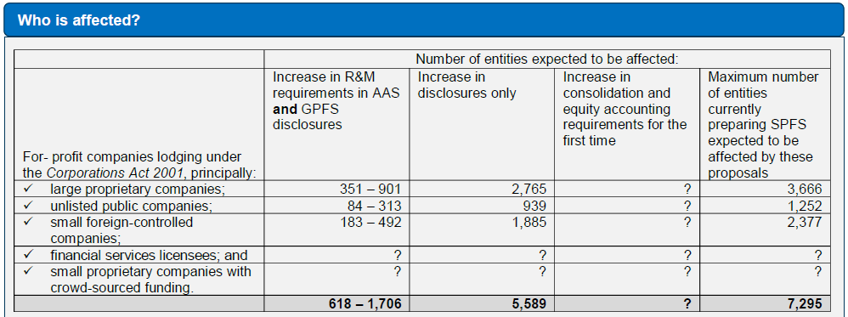
ED 297 – Removal of SPFR
Notes:
From AASB ED 297 – Key Facts

Slide 49
References / Further Reading
Dec 2018 – AASB For-profit User and Preparer Survey Results
Aug 2019 – AASB Financial Reporting Practices of For-Profit Entities Lodging Special Purpose Financial Statements
Sep 2019 – AASB Legislative and Regulatory Financial Reporting Requirements
https://asic.gov.au/regulatory-resources/financial-reporting-and-audit/preparers-of-financial-reports/lodgement-of-financial-reports/
AASB ED295 – SD to replace RDR
AASB ED297 – Removal of SPFR for some entities
ASIC 19-206MR – findings from 2018 inspections
Notes:
Business cards at registration desk or come talk to me

Slide 50
Questions?

Slide 51
Australian Audit
Australian Audit is a specialist audit firm of Chartered Accountants. With offices in the Perth CBD, we look forward to hearing how we can assist with your audit requirements.
info@ausaudit.com.au
08 9218 9922
Level 8, 251 St Georges Tce Perth WA 6000

