Slide 1
How to pass your settlement agent trust audit
Alastair Abbott | 8 July 2019

Slide 2
Housekeeping
Bathrooms
In case of Emergency
Food and Drinks
Mobile phones
Slides will be provided
Feedback
Notes:
Please ask questions as we go

Slide 3
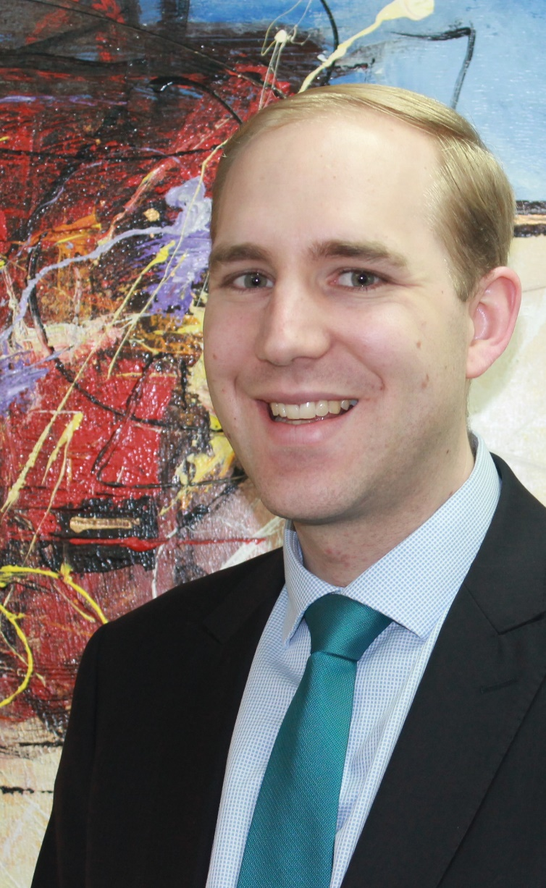
Alastair Abbott
CA, B.Comm., GradDipCA, M. Forensic Accounting, MAICD, Registered Company Auditor, Registered Self-Managed Super Fund Auditor
Joined Australian Audit in 2008, rising to position of Director in 2014
Completed his undergraduate studies at the University of Western Australia followed by the Chartered Accounting program.
Completed a Masters of Forensic Accounting through the University of Wollongong.
Has broad experience across all types of audits, from the smaller trust accounts, variable outgoings and strata companies through to financial statement audits for large companies, charities and financial service licensees.
Alastair@ausaudit.com.au | 08 9218 9922

Slide 4
Disclaimer
This presentation is for your general information only, and should not be taken as specific financial or business advice. You should not act, or refrain from acting, on the basis of this presentation alone, without seeking specific advice from your advisers.
Nevertheless, this presentation has been carefully prepared based on the information available at the time of the presentation.

Slide 5
Outline of this session
Audit outputs
Trust accounting requirements
Common errors

Slide 6
Audit outputs

Slide 7
Audit Outputs
By Auditor
Declaration by auditor
Statutory declaration by auditor
Management letter
By bona fide control (BFC)
Statutory declaration by person in bona fide control
Statement of trust account money held (Annexure A)

Slide 8
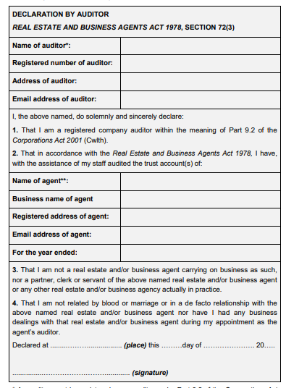
Declaration by auditor
That I am a registered company auditor within the meaning of Part 9.2 of the Corporations Act 2001 (Cwlth).
That in accordance with the Settlement Agents Act 1981, I have with the assistance of my staff audited the trust account
That I am not a settlement agent carrying on business as such, nor a partner, clerk or servant of the above named settlement agent or any other settlement agency actually in practice.
That I am not related by blood or marriage or have a defacto relationship with the above named settlement agent nor have I had any business dealings with that settlement agent.

Slide 9
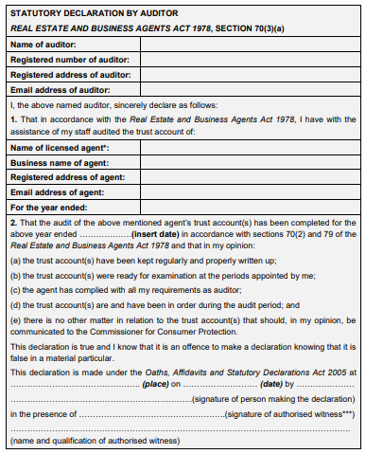
Statutory declaration by auditor
I, the above named, do solemnly and sincerely declare:
That in accordance with the Settlement Agents Act 1981, I have with the assistance of my staff audited the Trust Account
I declare the audit of the above mentioned agent’s trust account has been completed and I now report thereon in accordance with sections 51(2) and 60 of the Settlement Agents Act 1981, that in my opinion:
the trust accounts have been regularly kept and properly written up;
the trust accounts were ready for examination at the periods appointed by me;
the agent has complied with all my requirements as auditor;
the trust accounts are and have been in order during the year of the audit; and
there is no matter in relation to the trust accounts that should, in my opinion, be communicated to Consumer Protection, other than those matters included in my management letter.

Slide 10
Management letter
Further to our carrying out an audit of the XYZ Settlement Agent Trust Account for the year ended 30 June 2019, there were no matters to be reported to management. The books of account, files and general record keeping were of a high standard.
OR
Further to our carrying out an audit of the XYZ Settlement Agent Trust Account for the year ended 30 June 2019, there were the following matters to be reported to management. The books of account, files and general record keeping were of a high standard, other than the matters noted below.
[items listed]

Slide 11
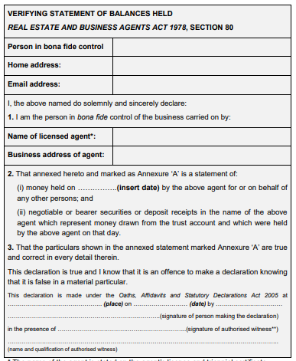
Statutory declaration by BFC
I sincerely declare as follows:
I am the person in bona fide control of the business
That annexed hereto and marked with the letter ‘A’ is a statement of (for the year ended 30 June 2019):
money held on the above year ended by the above agent for or on behalf of any other persons; and
negotiable or bearer securities or deposit receipts in the name of the above agent which represent money drawn from the trust account and which were held by the above agent on that day.
That the particulars shown in the annexed statement marked with the letter ‘A’ are true and correct in every detail therein.

Slide 12
Statement of trust account money held (Annexure A)

Slide 13
Trust accounting requirements

Slide 14
Bank Reconciliations – General Trust (49(6)(d))
The monthly trust account reconciliation should be:
as at the close of business of the last day of the month;
completed within 10 working days after the end of each month;
verified, signed and dated by the agent, or if the agent is a corporation, the person in bona fide control, even if there are no funds in the account; and
retained for auditing purposes
Unpresented cheques to be followed up
Adjustments not to be carried forward continuously

Slide 15
Bank Reconciliations – Interest Bearing Trust
IBTA for >$20,000 or >60 days
Reconcile within trust accounting software is best practice
May use portfolio approach, e.g. off the plan developments
Lot # | BSB | Acct # | Account Name | Opening Balance | Deposits | Withdrawals | Interest | Fees | Closing Balance
1 | 123-123 | 45678912 | XXX | $$$ | $ |  | $ | -$ | $$$
2 | 123-123 | 45678913 | XXX | $$$ |  | -$ | $ | -$ | $$$
3 | 123-123 | 45678914 | XXX | $$$ |  |  | $ | -$ | $$$

Slide 16
Account Naming (Regulation 6B)
Sole trader
SA Trust Account – Mary Smith T/A XYZ Settlements – TC12345
Partnership
SA Trust Account – Mary Smith and Bill Jones T/A ABC Settlements – TC12346
Body corporate
SA Trust Account – ABC Pty Ltd T/A DEF Settlements – TC12347
Interest Bearing Trust Accounts
SA Trust Account – IB – ABC Pty Ltd T/A DEF Settlements in trust for Joe Smith – TC12347
Opening and closing accounts – must advise DMIRS (standard form)

Slide 17
Depositing trust money
Receipt issued and all details included (Regulation 6E)
Not required for electronic receipts
All trust money must be deposited in the trust account with an authorised financial institution as soon as practicable after it is received. (49(1))
It is the view of the Department that, ‘as soon as practicable’ means by close of business the next working day.
Notes:
Contents of trust receipts
It is a requirement that all trust receipts show the following information:
the name of the holder of the triennial certificate, and the business name of the holder, that is recorded in the register;
a number or letter, or a combination of both, in consecutive order that allows the receipt to be uniquely identified;
the date on which the money was received;
the name of the person paying the money;
the amount of money received;
a brief description of the purpose of the payment; and
if the receipt is hand-written, the name of the person receiving the money evidenced by the signature of that person.
Reference: Regulation 6E of the Regulations

Slide 18
Withdrawing trust money
Cheques (if used)
Never pre-signed,
Insert “not negotiable – account payee only”
cross out “or bearer”
Ensure funds cleared before disbursing
Overdrawn account / trust ledger (49C(3))
Advise DMIRS & Auditor immediately
Replace funds from Agent’s general account

Slide 19
Client Files
Records are properly maintained and can be conveniently and properly audited (49(6))
List of clients / files
Full and accurate records of receipts and payments are maintained (49(6))
Added to each file, or in software
Entitlement to commissions (43 & 44)
Validly appointed & settlement has occurred
Charges agreed & support for expenses

Slide 20
Client Files
Valid authority to act (43)
Signed by client (43(2))
Identifies property (43(2)(a))
Copy given to client (43(2)(c))
Statement on commissions (Regulation 6AA)
Security of documents (Privacy Act)
IT Security / physical security / back-ups
Mandatory data breach reporting
Verification of ID (Article 10 of Code of Conduct)

Slide 21
Other Requirements
No buffer funds
Record & narration for journals
Sufficient details
Quarterly audit for new settlement agents
Termination audit
Due 5 months after closing

Slide 22
Proactive Compliance
Checklist used is available
https://www.commerce.wa.gov.au/publications/proactive-compliance-visits-settlements-agents
Ensure you are complying with all items
Breach in proactive visit may also have to be reported in audit visit

Slide 23
Unclaimed Monies
Lodgement process is long, involves lots of waiting
All unclaimed monies should be in one ledger
Should not be adjustments on bank reconciliation
Report to Treasury January each year
Have been holding money >2 years
18 months later Treasury will request payment
http://www.treasury.wa.gov.au/Unclaimed-money/Lodging-Monies-with-Treasury/

Slide 24
Common errors

Slide 25
Bank Reconciliations – common errors
Not signed
Not dated
Dated more than 10 business days after month end
Not to last business day of month
IBTA not reconciled
IBTA interest not recorded

Slide 26
Authority to act – common errors
Not signed by client correctly
Acting for both parties – approval not on file

Slide 27
Other Common Errors
Certificates not on display
Expired certificate on display
Buffer funds
Suspense accounts
Agents fees not disbursed promptly
Errors in statutory declarations
Delay in depositing funds to trust account
Failure to report overdrawn accounts

Slide 28
More Information
Settlement Agents’ Trust account handbook (28 pages)
A guide to auditing trust accounts: Real estate agents, business agents, and settlement agents and business settlement agents (50 pages)
Settlement Agents Act 1981
Settlement Agents Regulations 1982
DMIRS Newsletter (https://www.commerce.wa.gov.au/publications/subscribe-property-industries-bulletins)
Australian Audit Newsletter (https://australianaudit.com.au/newsletter)
https://www.commerce.wa.gov.au/consumer-protection/auditing-settlement-agents-forms-and-publications

Slide 29
Take away messages
Read “Trust account handbook for settlement agents” by DMIRS
Use a checklist to ensure all requirements are complied with
Complete a ‘pro-active compliance audit’ on yourself

Slide 30
Questions?

Slide 31
Australian Audit
Australian Audit is a specialist audit firm of Chartered Accountants. With offices in the Perth CBD, we look forward to hearing how we can assist with your audit requirements.
info@ausaudit.com.au
08 9218 9922
Level 8, 251 St Georges Tce Perth WA 6000

